Slide 1
Bad arguments and logical fallacies
Easton White
Alan Hastings
Winter 2018

Slide 2
Free write on a sheet of paper (2 min)

Slide 3
Free write on a sheet of paper (2 min)
What was your impression of Sagan’s Baloney detection kit?
Why use the kit?
Is the kit still relevant today?

Slide 4
Pick out the logical fallacies

Slide 5
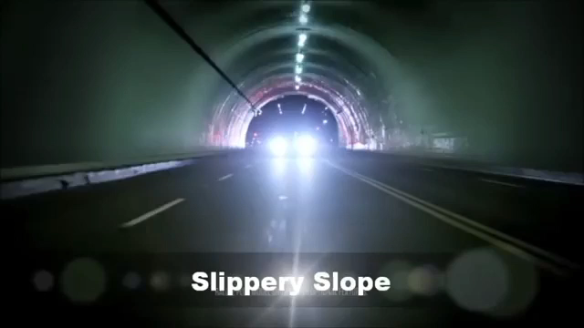
Notes:
Slippery slope, ad hominen/ Red herring, ad hominen, hasty generalization/no data behind claim (Marilyn Quayle
)

Slide 6
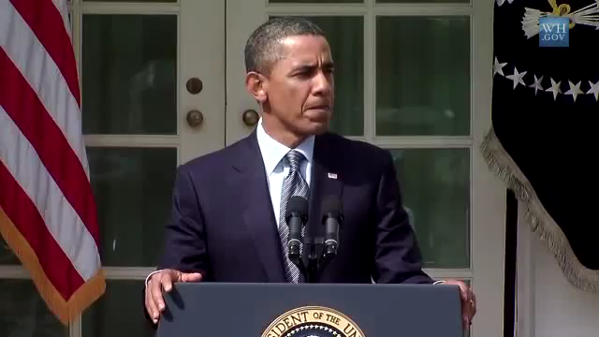
Notes:
False dichotomy

Slide 7
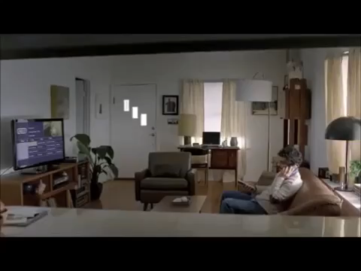

Slide 8
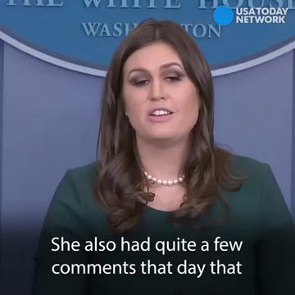
Notes:
Argument from authority

Slide 9
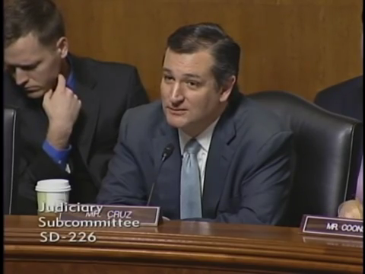
Notes:
Cherry-picked data, weasel words

Slide 10
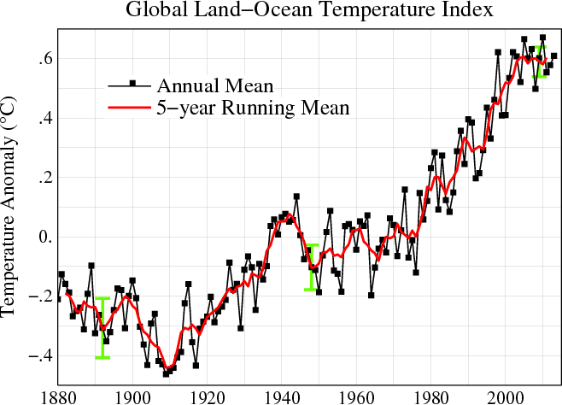
Satellite data over past 18 years (said in 2015)

Slide 11
Satellite data over past 18 years (said in 2015)
Notes:
https://climate.nasa.gov/vital-signs/global-temperature/

Slide 12
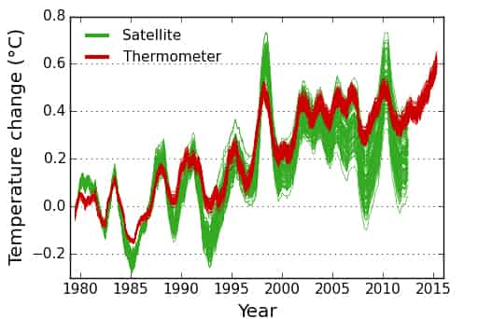
Satellite data over past 18 years (said in 2015)
Notes:
http://www.politifact.com/truth-o-meter/statements/2015/mar/20/ted-cruz/ted-cruzs-worlds-fire-not-last-17-years/

